Slide 1

Cross Domain Alignment and Community Engagement
Lain McNeill, NIEM NBAC Member-at-Large
EM Domain Facilitator Team
PM DoD Biometrics
December 12, 2017

Slide 2
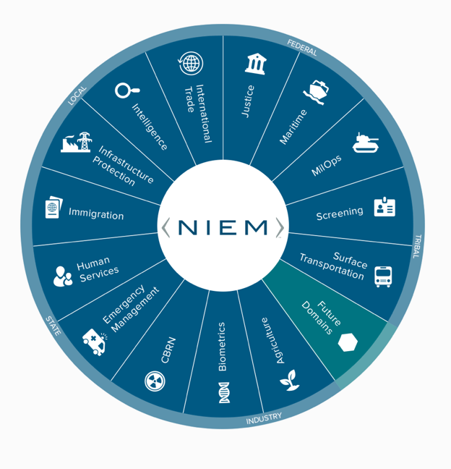

THE NIEM DOMAIN SYSTEM

Slide 3
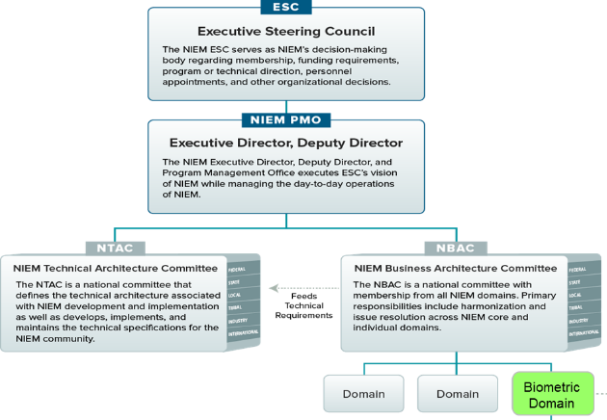
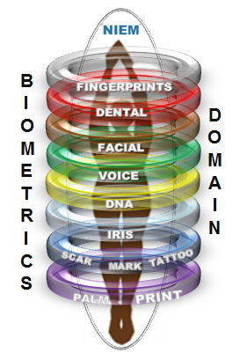
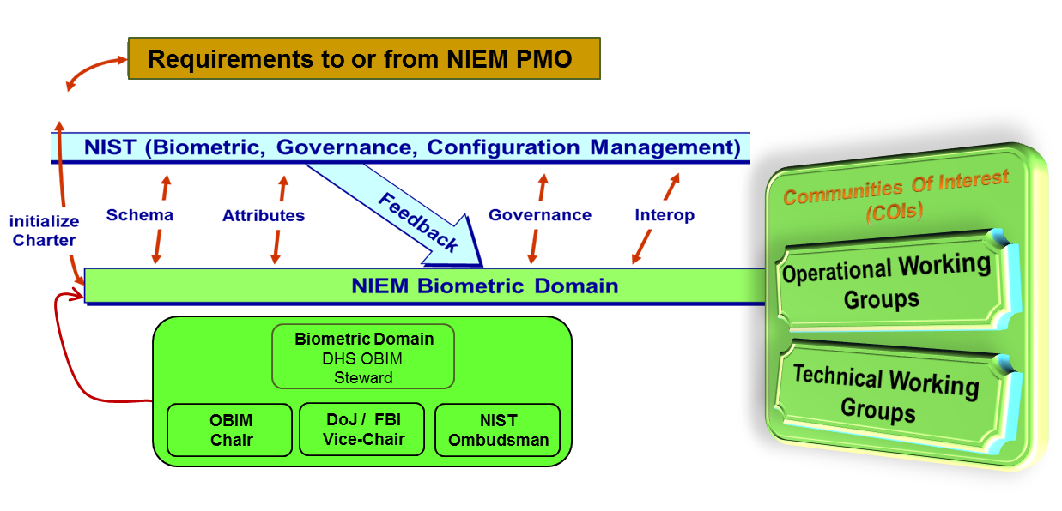
BIOMETRICS DOMAIN ORGANIZATION
Operating under the stewardship of DHS OBIM, NBD was established in Sept 2012 to support biometric-related services and mission-based activities, such as national defense, border management, immigration benefits and global law enforcement, and credentialing.
NBD Steward
DHS OBIM
The Governance Committee stewards the domain and brings together communities of interest to identify biometric related info sharing REQs in both day-to-day operational situations
Chair
DHS OBIM
Vice-Chair
DoJ /FBI
Vice-Chair
DoD
Communities of interest includes:
Federal
State
Local
Tribal
Industry
International
3
Notes:
DHS OBIM IS THE STEWARD OF THE BIOMETRICS DOMAIN
Apart from the Chair, which is set by the steward organization, there are two co-chairs, mandated by Charter as two primary stakeholders within identity management (DoJ and DoD)

Slide 4
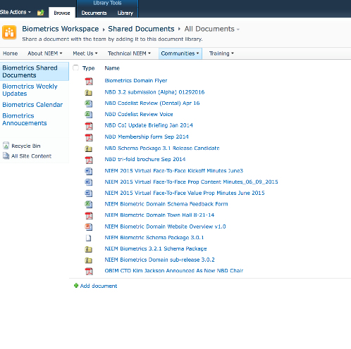
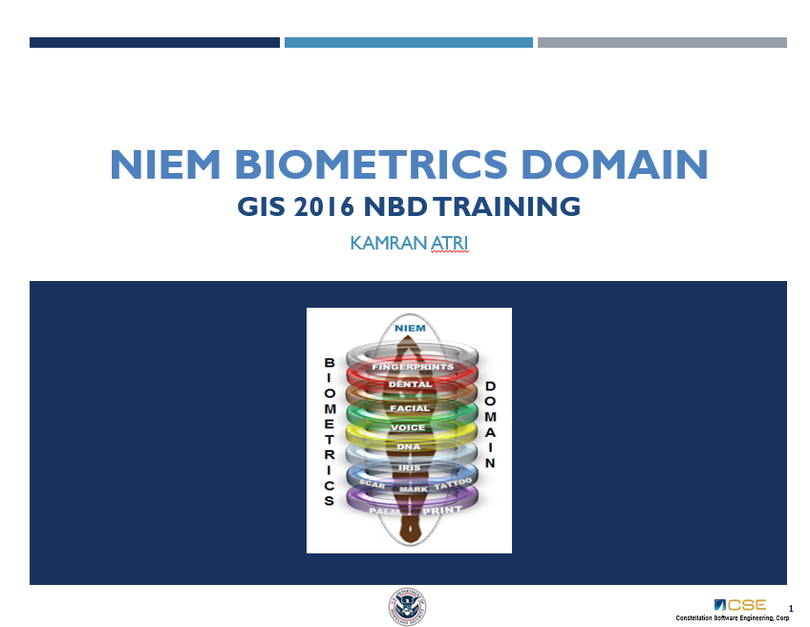
BIOMETRICS DOMAIN ENGAGEMENT
NIST Biometrics Standard Evolution
The Biometrics Domain supports the ANSI/NIST-ITL XML working group chaired by NBD Co-Chair Will Graves (DoD) in 2015 and currently chaired by Jennifer Stathakis (DoJ FBI)
NBD Schema Enhancement
July 2017 NIEM 4.0 release saw increased harmonization with OBIM IXM (6.0.9) and DoD EBTS (4.0). Incremental release 4.1 further aligns to the ANSI/NIST-ITL Working Group 2017 Updates, while 4.2 and beyond will align to the planned ITL 2018 Refresh
NIEM Activities
Continued community outreach, participation in 2016 and 2017 NBAC State and Local Tiger Team, Domain Lifecycle Tiger Team, International Tiger Team, 4.0 and NBAC technical review and mentorship activities.
Technical Assistance/Outreach/Training
GIS September 2016
NIEM 4.0 Review Biometrics Review Team
DoD (DFBA) EBTS 4.0 Technical Review
4

Slide 5
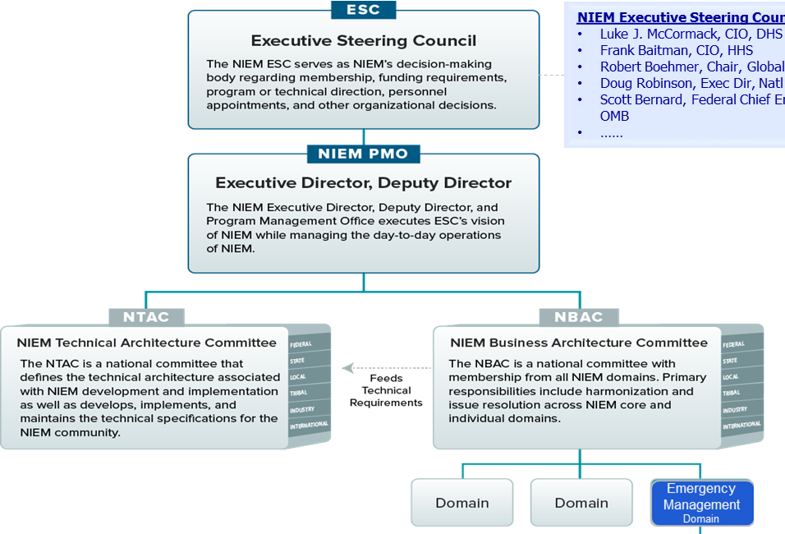
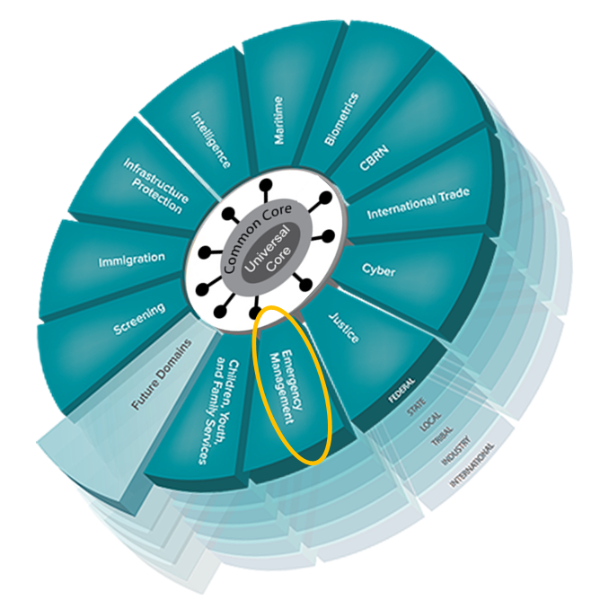
EMERGENCY MANAGEMENT DOMAIN
The EM Domain is Mission-based and organized to capture and facilitate standardized Info Sharing to enhance Resiliency
Emergency
Management
Domain
IMA
Committee
The Domain Facilitator manages day-to-day OPS of the Domain, such as data model MGMT, Tiger team tasking, Training, Membership and Outreach. EM IEPDs reviews and assessment,,,,
Chair
DHS S&T FRG
Domain
Facilitator
(Core Members)
Federal
(FEMA, S&T, NPPD, …)
State
Local
Tribal
Industry
International
5

Slide 6

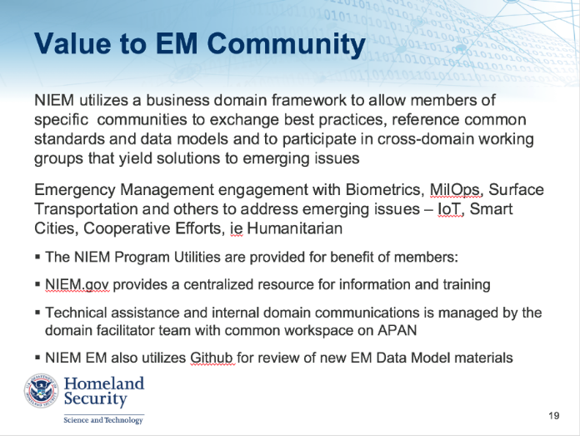
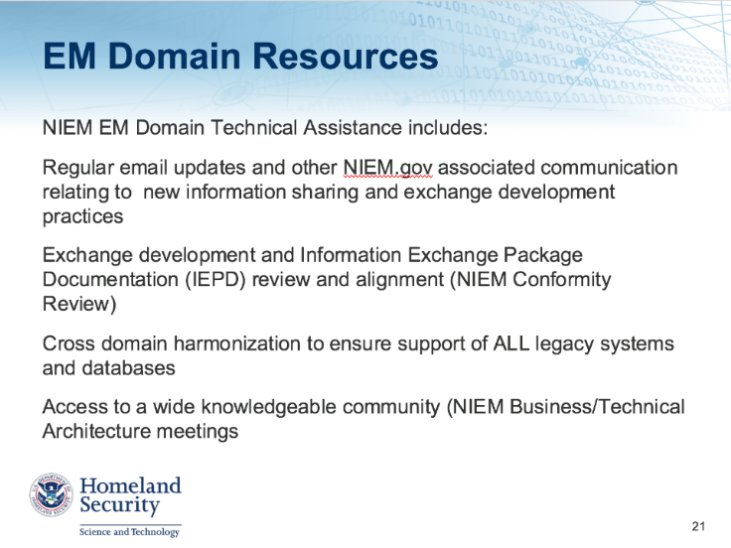
EM DOMAIN ENGAGEMENT
NIEM PMO / NBACD
Training / Tech Assistance
Model MGMT
Domain Members / Stakeholders
Outreach
6

Slide 7
EM DOMAIN TECHNICAL SERVICES
Support development of organizational data, information models and dictionary.
2. Assessment & analysis of existing data exchanges (business context & data requirements).
3. Gap analysis of existing data exchanges vs. national or international data standards (rapidly evolving due to International NIEM expansion).
4. Development and standardization of organizational data exchanges (IEPD development and review, eg, FEMA PDA IEPD and Fairfax County/NCR Updates).
5. Evaluate and promote organizational data standards nationally and internationally through NIEM EM Domain at NIEM.Gov and representation at standards meetings.
6. NIEM conformant assessment of the Organizational information models.
7. Cross-organizational data exchange harmonization guidance and facilitation.
8. Identify, review and share technical issues and training based on best practices.
7

Slide 8
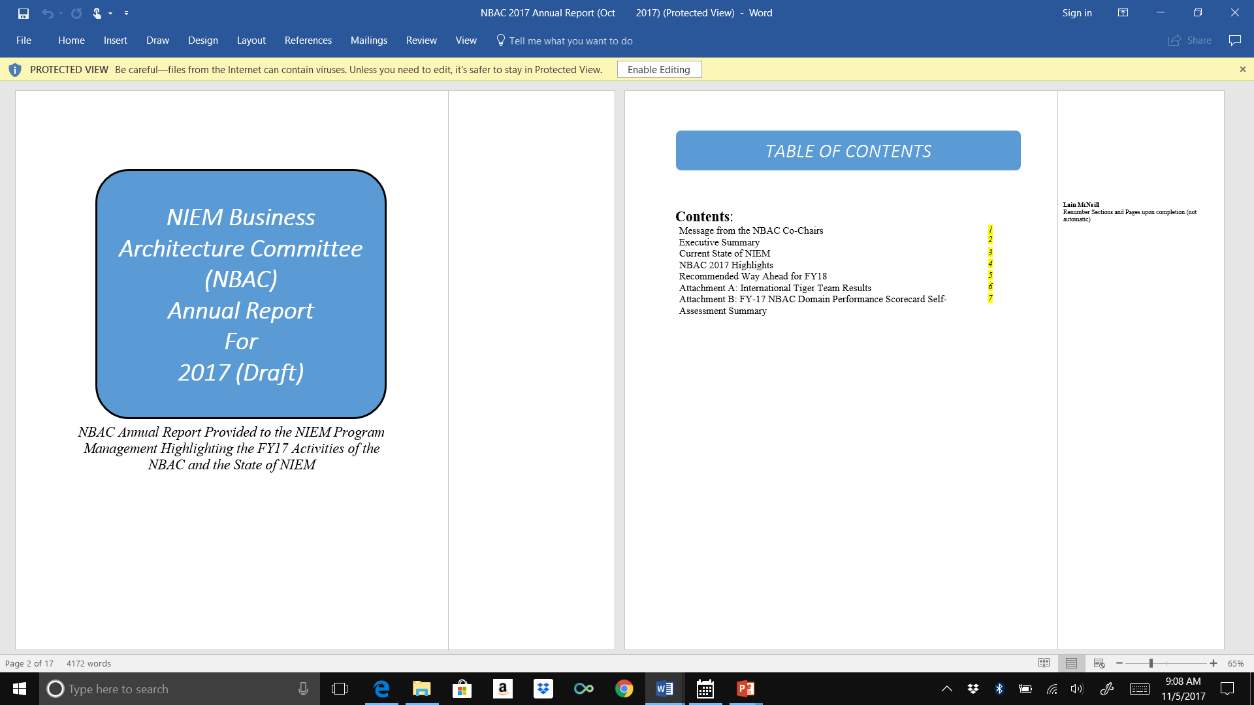
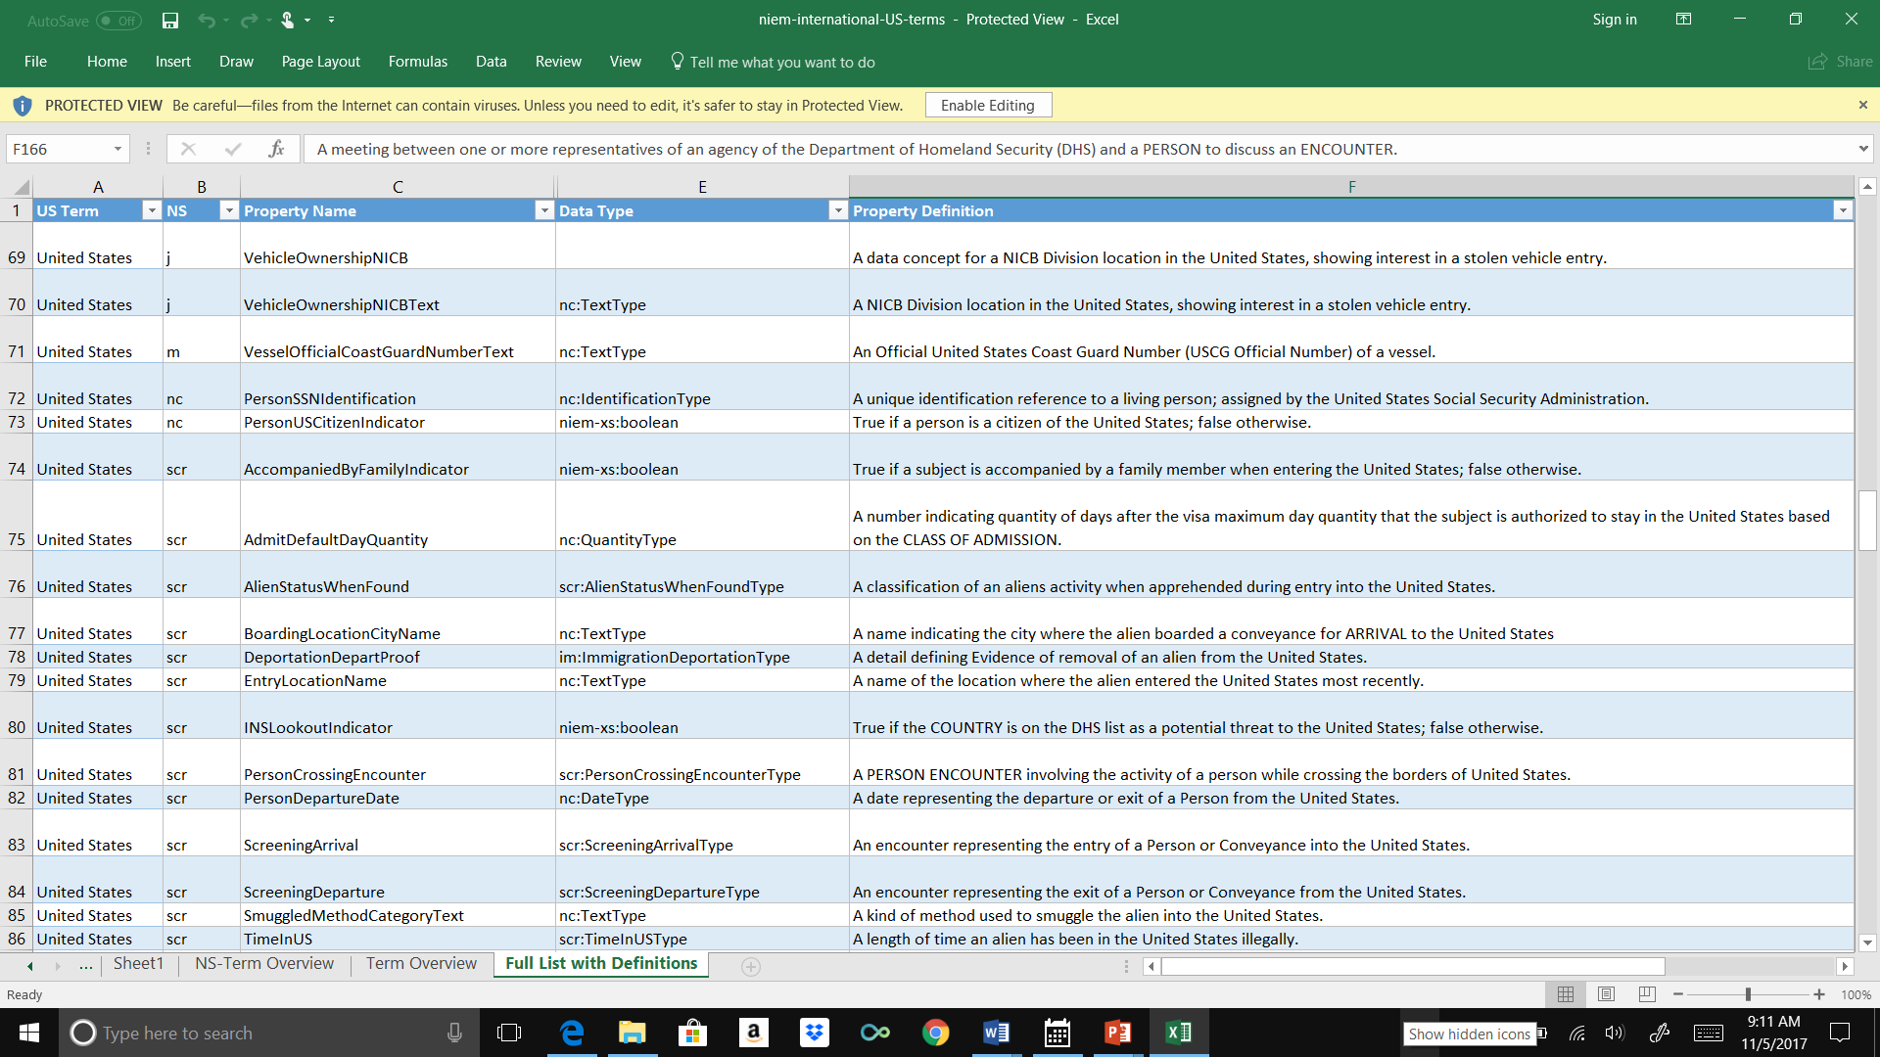
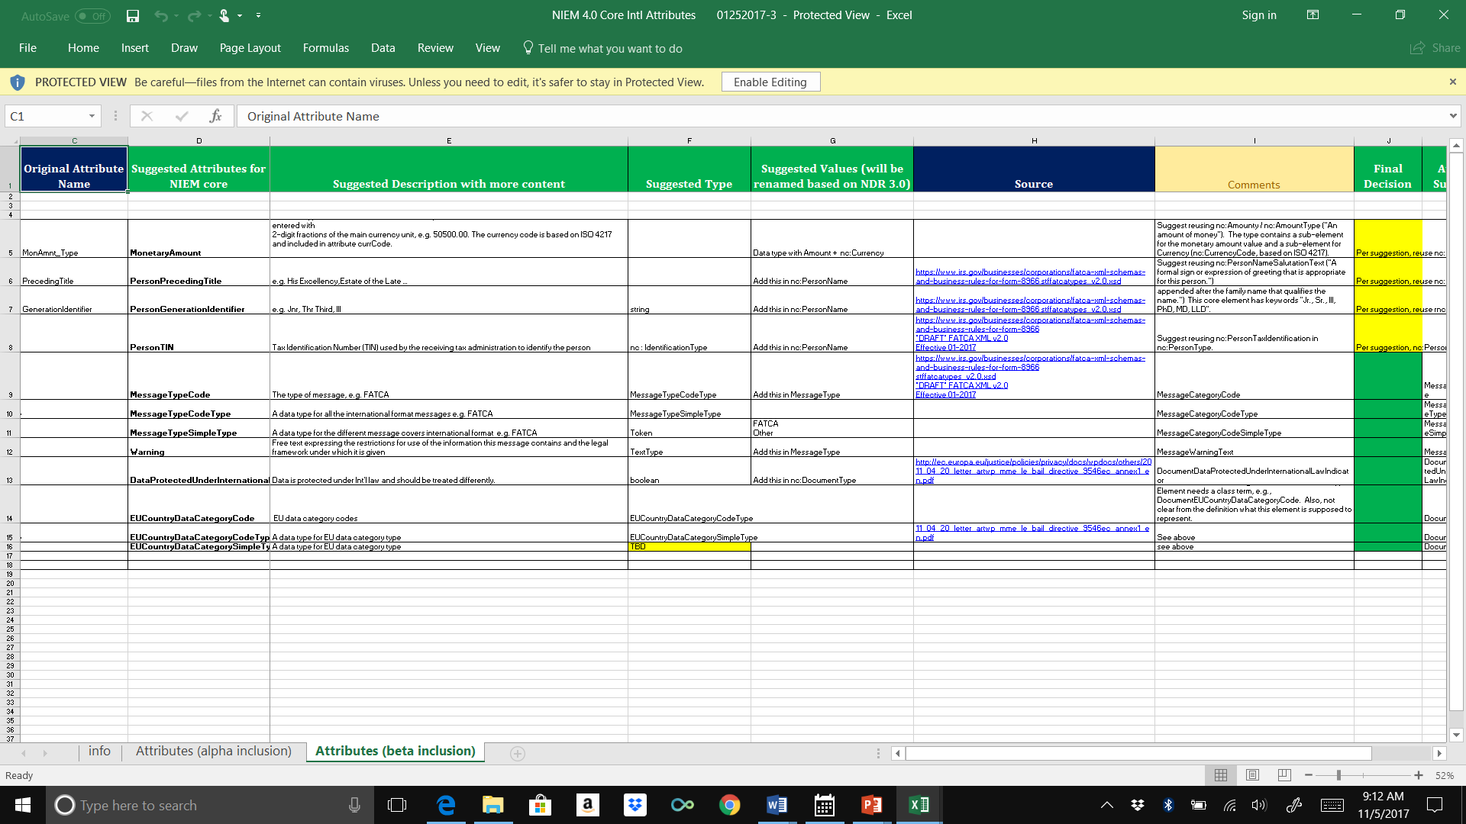
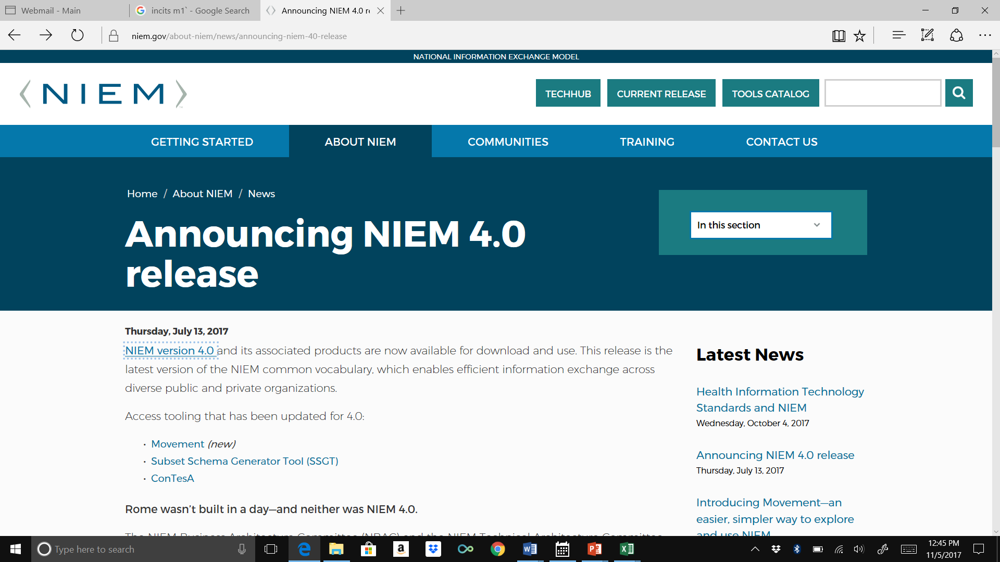
2017 NIEM INTERNATIONALIZATION
Recurring Meetings
4.0 Content Team Collaboration
NIEM 4.0 Release
Strategic Roadmap Inclusion
8

Slide 9

2018 INT’L TT PRIORITIES
1) Expanded Membership
The NBAC continues to be an active committee and major expansionary driver within the NIEM Program, gaining momentum in the establishment of new domains and increased adoption across the whole of government.
Moving forward, NBAC intends to emphasize outreach and continued program expansion with plans to refresh the stewardship and management of stagnant domains and further expand international participation and utilization.
The International Tiger Team will fulfill this guidance with identification of potential new members (global) and offers of opportunity for participation, collaboration and technical assistance.
9

Slide 10

2018 INT’L TT PRIORITIES
2) Grassroots Outreach
With the 4.0 release over and only incremental releases scheduled for the near term, the International Tiger Team can focus less on immediate model development and more on the larger community concerns and issues with respect to utilization of NIEM internationally.
The International Tiger Team plans to maintain more of a grassroots approach to engagement in FY18 with a focus on:
Identification of new data models, attributes and exchanges
Technical Assistance and advisory for members, stakeholders and potential adopters
Community of Interest Education (updated training modules and targeted workshops/briefings)
10

Slide 11
2018 INT’L TT PRIORITIES
3) Next Generation Collaboration/Sub-Working Groups establish International Tiger Team as Deliverable-oriented
Local Languages into NIEM (Canada lead)
Domestic Artifacts expanded to International Frameworks
Cross-standard alignment and higher level frameworks (Example NIEM EM : ISO + Stakeholder Internal + International Humanitarian aligned to NATO/MilOps Frameworks)
Canada
Structures
Mapping
11

Slide 12



NBAC STRATEGIC ROADMAP
The NBAC Strategic Roadmap (FY2017-18) provides an overview of NBAC, including Core Ideology (Vision, Mission and Values), Fundamental Drivers and Goals and Deliverables for the 2017-18 period
As stated within the document, the Core Mission of the NBAC is “to set the business architecture and requirements of NIEM, manage NIEM core, and facilitate the processes for the regulation and support of NIEM domains.”
The 10 goals put forth in the Strategic Roadmap:
Advance the Enterprise Model approach to adopt NIEM
Lead internationalization of NIEM
Advance each domain’s maturity
Maintain alignment across NBAC, NIEM PMO and NTAC
Produce periodic quality model content update
Increase adoption of NIEM
Ensure continuous committee improvement
Elevate NIEM implementation
Embrace transparency in governance and model management
Maintain NIEM relevance as technologies emerge

Slide 13
CONTACT
For more information about the NIEM EM Domain, please contact:
NIEM-EM-Facilator@cse-corp.com
Lain McNeill, Interoperability & Standards
Phone: 703-501-4208
Email: lain.mcneill@cse-corp.com

Slide 14
THANK YOU!

